Slide 1




Slide 2

MANACHER’S ALGORITHM

Slide 3

TEST TIME ON MOVE HYPHEN TO BEGINNING
URL: https://forms.gle/eujGZJtiSaQ9aKbz5
QR CODE:

Slide 4
MANACHER’S ALGORITHM
Manacher’s Algorithm to the rescue!
Manacher’s Algorithm helps us find the longest palindromic substring in the given string.
Manacher’s algorithm solves this task in Linear Time.
It optimizes over the brute force solution by using some insights into how palindromes work.

Slide 5
Question: 01
MANACHER’S ALGORITHM
Question: 01
Notations
Let’s focus on odd length palindromes for simplicity.
Let c be the center of the longest length palindrome we have encountered till now.
Let l and r be the left and right boundaries of this palindrome, i.e., the left-most character index and the right-most character index respectively.
Now, let’s take an example to understand l + c + r.

Slide 6
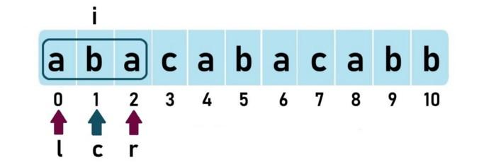
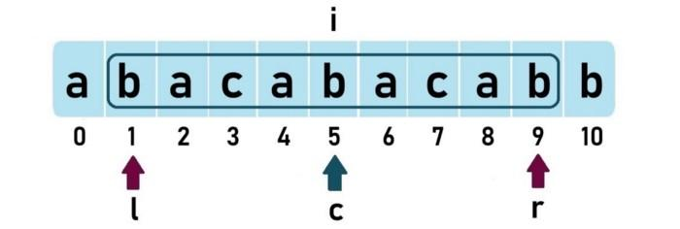
Question: 01
MANACHER’S ALGORITHM
Question: 01
Algorithm: Take an example “abacabacabb”
When going from left to right, when i is at index 1, the longest palindromic substring is “aba” (length = 3)
The answer for the given string is 9 when the palindrome is centered at index 5; c, l, and r are as follows:

Slide 7
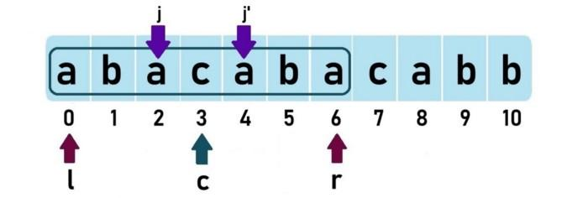
Question: 01
MANACHER’S ALGORITHM
Question: 01
Concept: Mirror Index
For any palindrome centered at a center c, the mirror of index j is j-¹ such that
c-j = j-¹ - c.
So, mirror index of j is...
j-¹ = (2 X c) - j
For palindrome “abacaba”, the mirror of j is j-¹ and the mirror of j-¹ is j.
Now, come back to the algorithm

Slide 8
Question: 01
MANACHER’S ALGORITHM
Question: 01
When we move i from left to right, we try to “expand” the palindrome at each i.
Expand means, that we’ll check whether there exists a palindrome centered at i and if there exists one, we’ll store the “expansion length” to the left or to the right in a new array called P[] array or (some prefer) LPS[].
If the palindrome at i expands beyond the current right boundary r, then c is updated to i and new l, r are found and updated.

Slide 9
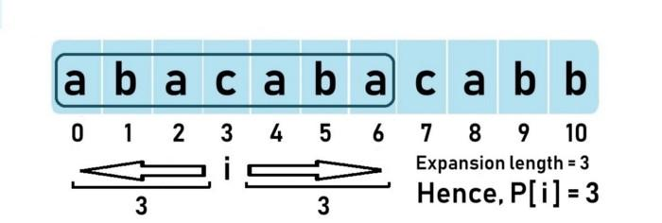
Question: 01
MANACHER’S ALGORITHM
Question: 01
Example
Let’s take the previously discussed palindrome “abacaba” which is centered at i = 3.
Therefore, the P[] array stores the expansion. length of the palindrome centered at each index.
But we don’t need to manually go to each index and expand to check the expansion length every time.
This is exactly where Manacher’s algorithm optimizes better than brute force, by using some insights on how palindromes work.

Slide 10
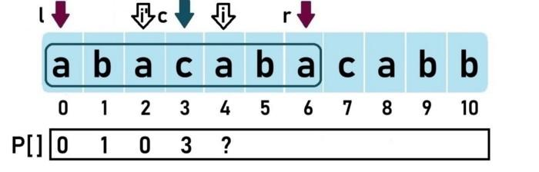
Question: 01
MANACHER’S ALGORITHM
Question: 01
Optimization Explained
Remember that c indicates the center of the current longest odd length palindrome. And l, r denote the palindrome’s left and right boundaries.
Let’s see the P[] array for the string “abacaba”.

Slide 11
Question: 01
MANACHER’S ALGORITHM
Question: 01
When i = 4, the index is inside the scope of the current longest palindrome, i.e., i < r. So, instead of naively expanding at i, we want to know the minimum expansion length that is certainly possible at i, so that we can expand on that minimum P[i] and see, instead of doing from start. So, we check for mirror i’.

Slide 12
Question: 01
MANACHER’S ALGORITHM
Question: 01
Optimization
As long as the palindrome at index i’ does NOT expand beyond the left boundary (l) of the current longest palindrome, we can say that the minimum certainly possible expansion length at i is P[i’].
Remember that we are only talking about the minimum possible expansion length, the actual expansion length could be more and, we’ll find that out by expanding later on. In this case, P[4] = P[2] = 0. We try to expand but still, P[4] remains 0.

Slide 13
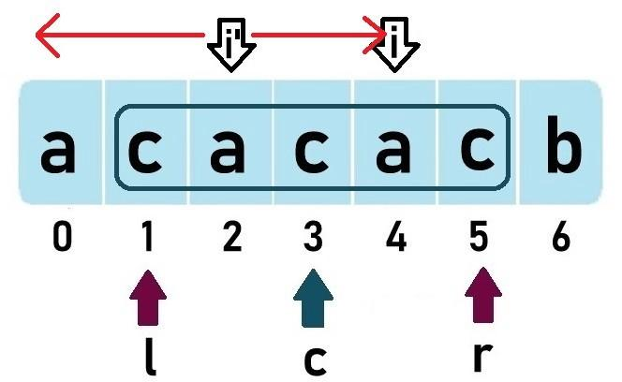
Question: 01
MANACHER’S ALGORITHM
Question: 01
Now, if the palindrome at index i’ expands beyond the left boundary (l) of the current longest palindrome, we can say that the minimum certainly possible expansion length at i is r-i.
So, P[4] = 5–4 = 1
You could ask but why can’t the palindrome centered at i expand after r in this case? If it did, then it would have already been covered with the current center c only. But, it didn’t. So, P[i] = r-i

Slide 14

Question: 01
MANACHER’S ALGORITHM
Question: 01
If palindrome at i were to expand beyond r, then the character at index 6 should have been ‘a’. But if that were to happen, the current palindrome centered at c would NOT have been “cacac” but “acacaca”
So, we can sum the two quoted points above as the

Slide 15
Question: 01
MANACHER’S ALGORITHM
Question: 01
Algorithm Continued
Now the only thing left is to expand at i after P[i], so we check characters from index (P[i] + 1) and keep expanding at i.
If this palindrome expands beyond r, update c to i and r to (i + P[i]).
The P[] array is now filled and the maximum value in this array gives us the longest palindromic substring in the given string
This works for odd lengthed strings only. we simply append N + 1 special characters (say ‘#’) in between every two characters, just to make sure that our modified string is always of odd length.
Examples:
aba -> #a#b#a#
abba-> #a#b#b#a#

Slide 16
Question: 01
MANACHER’S ALGORITHM
Question: 01
public class EthCode { int manachersAlgorithm(String s, int N) { String str = getModifiedString(s, N); int len = (2 * N) + 1; int[] P = new int[len]; int c = 0; //stores the center of the longest palindromic substring until now int r = 0; //stores the right boundary of the longest palindromic substring until now int maxLen = 0; for (int i = 0; i < len; i++) { //get mirror index of i int mirror = (2 * c) - i; //see if the mirror of i is expanding beyond the left boundary of current longest palindrome at center c //if it is, then take r - i as P[i] //else take P[mirror] as P[i] | if (i < r) { P[i] = Math.min(r - i, P[mirror]); } //expand at i int a = i + (1 + P[i]); int b = i - (1 + P[i]); while (a < len && b >= 0 && str.charAt(a) == str.charAt(b)) { P[i]++; a++; b--; } //check if the expanded palindrome at i is expanding beyond the right boundary of current longest palindrome at center c //if it is, the new center is i

Slide 17
Question: 01
MANACHER’S ALGORITHM
Question: 01
if (i + P[i] > r) { c = i; r = i + P[i]; if (P[i] > maxLen) { //update maxlen maxLen = P[i]; } } } return maxLen; } String getModifiedString(String s, int N) { StringBuilder sb = new StringBuilder(); for (int i = 0; i < N; i++) { sb.append("#"); sb.append(s.charAt(i)); } sb.append("#"); return sb.toString(); } | public static void main(String args[]) { String str = "inputstring"; System.out.println(manachersAlgorithm(str)); } }

Slide 18
Question: 01
MANACHER’S ALGORITHM
Question: 01
Complexity
Lenier Time Complexity :O(n)
Auxiliary Space : O(n)

Slide 19




THANK YOU
+91 78150 95095
codemithra@ethnus.com
www.codemithra.com

